Slide 1
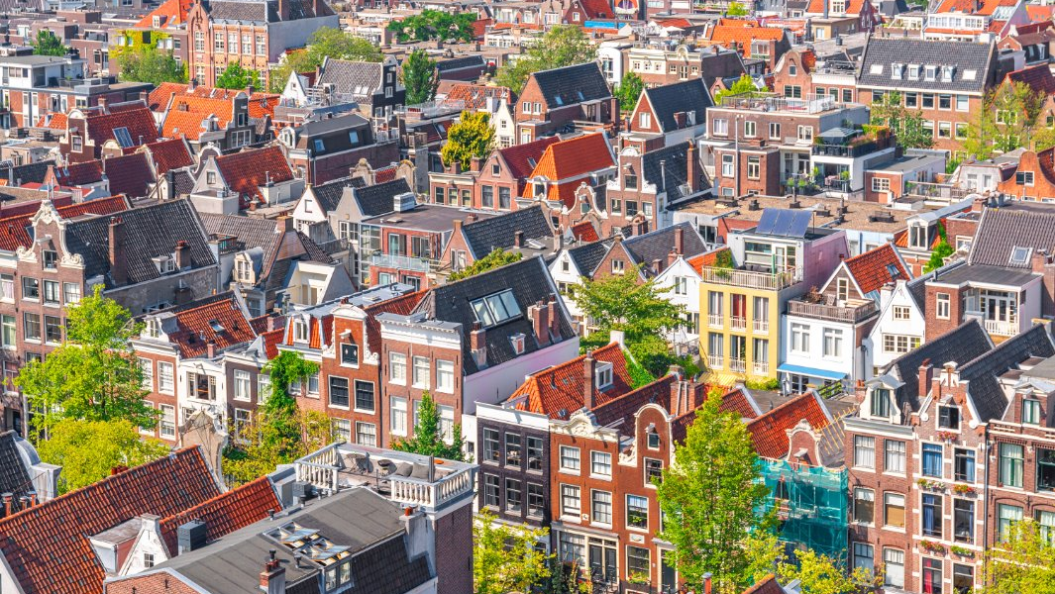
Affordable Housing Advocacy on the North Shore of Boston
Rosa Ordaz
Director of Community Engagement & Services
Harborlight Homes

Slide 2
Who We Are
Non-Profit Community Development Corporation (CDC)
Builds and manages affordable housing for seniors, families, individuals, disabled, and people affected by homelessness
Most housing is at 30-60% AMI
In house property management and resident services to support seniors to age in place and families to thrive

Slide 4
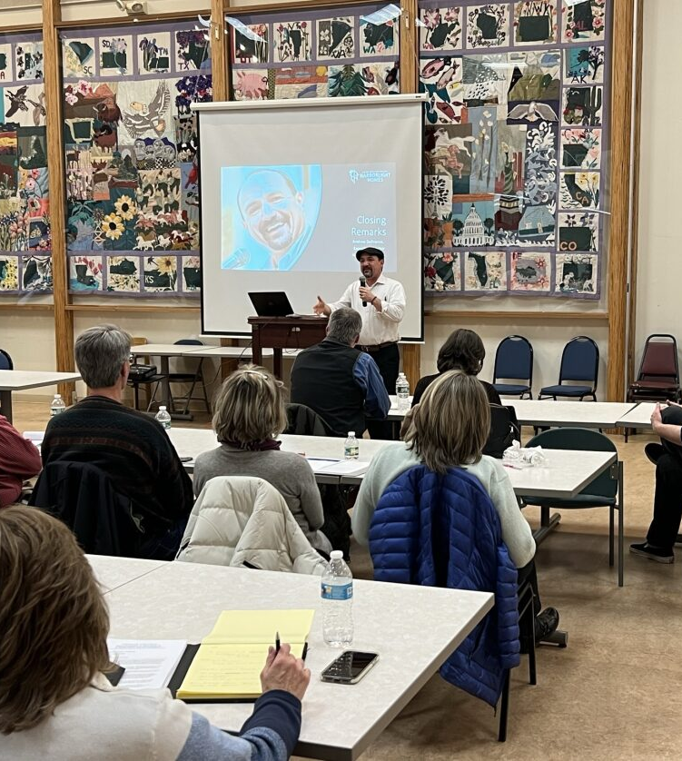
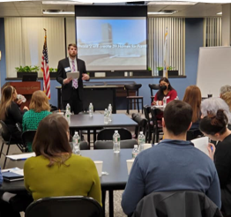
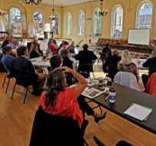
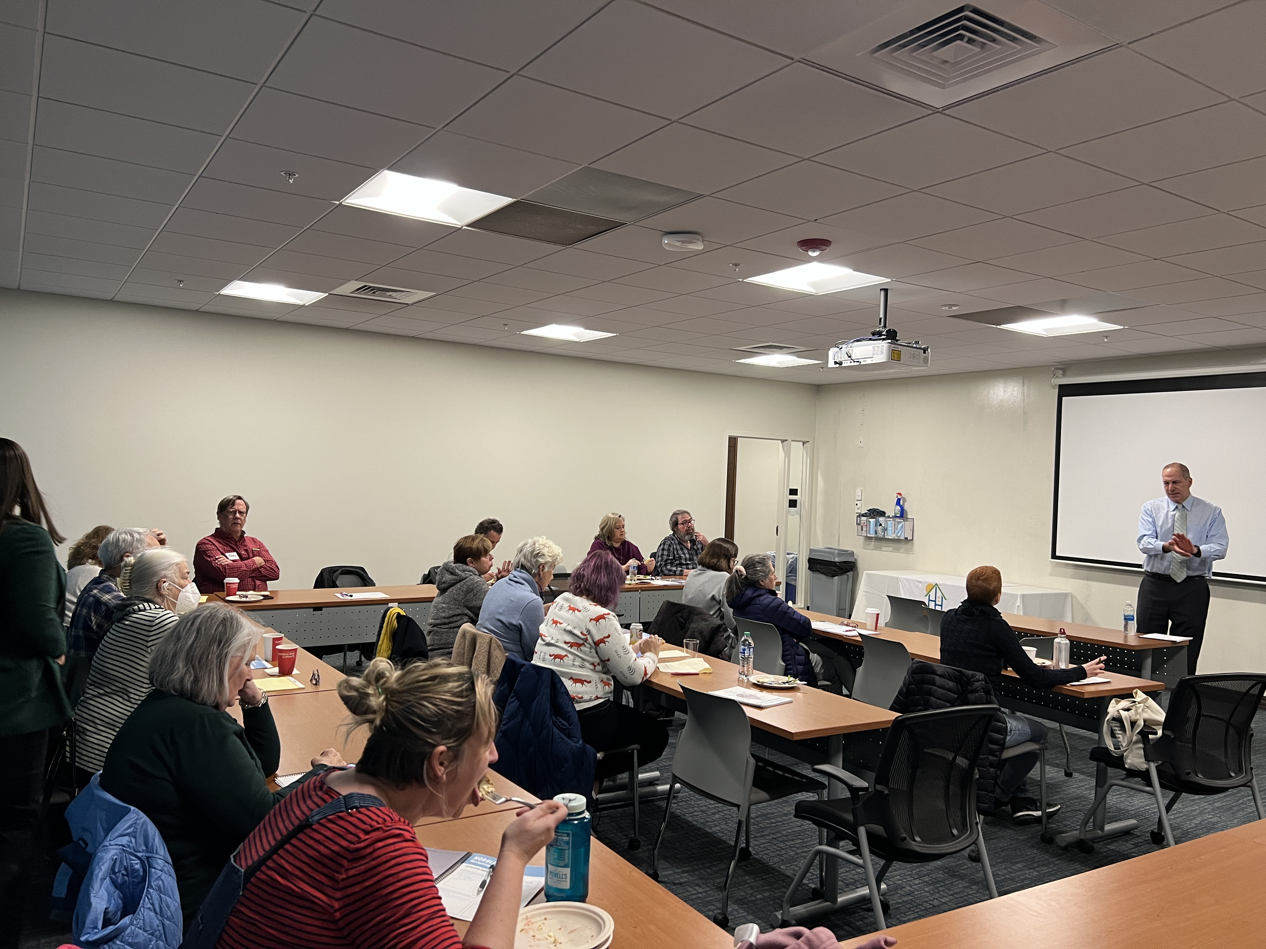
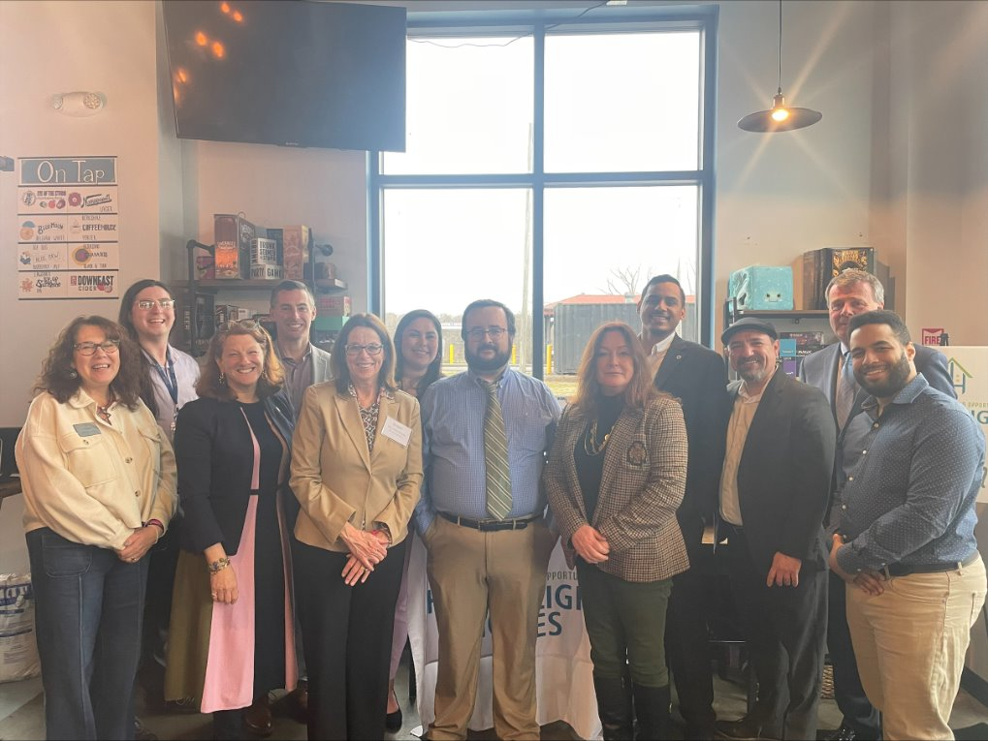
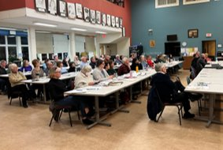
Advocacy & Education
Housing Institute
Housing Stewards Program
Community Forums
First Time Homebuyer Courses
Legislative Breakfast, Appy Hours, Lobby Days, & Year-Round Advocacy
Dirty Deeds Project
Testimony and local advocacy for housing friendly policies
al advocacy for housing friendly policies

Slide 5
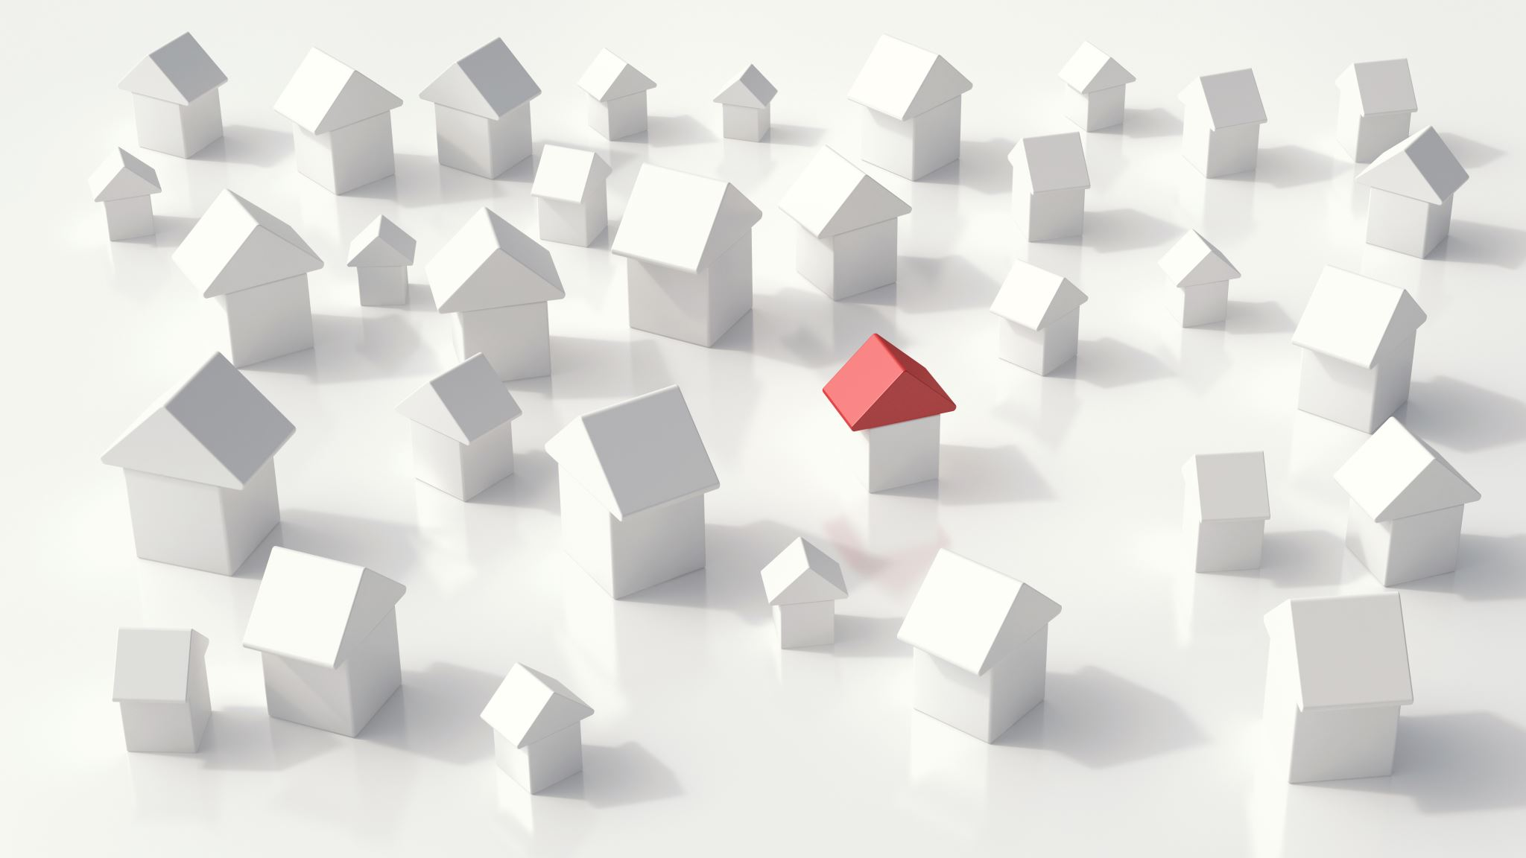
There is a lot that is misunderstood about affordable housing

Slide 6
… Why Advocacy?
Data shows that those who show up to public meetings tend to be older, male, white, and homeowners who tend to oppose new housing construction
Who is missing from these important meetings and why?
There is a strong correlation between community support and the construction of new housing, especially if affordable
It is essential that support is already present when a development is proposed
The North Shore, as much of the Commonwealth, is diverse and made up of many small municipalities with different forms of government, zoning, and priorities
Mix of cities and towns with a wide range between dense, multi-family by right in some cities adjacent to rural, single family only
Notes:
Even if supportive in the abstract, they tend to oppose specific developments
*Einstein, Palmer, and Glick 2017: Who Participates in Local Government

Slide 7
In depth sessions covering the basics of affordable housing and how to support the creation of it
Housing 101 style: basic definitions, zoning, local and state government
Tailored for your average Jo(e); often advocates or folks that want to get involved but are unsure how
Presented by Harborlight Staff

Slide 8
Brief informative sessions to support the advancement of affordable housing
More technical than Housing Stewards
Tailored for those serving on local housing related boards and commissions (ZBA, Planning Board, AHTF, City Council, etc.)
Guest Speakers & topics vary depending on location and current issues

Slide 9
Lessons Learned
Relationships are key; people crave community
Our communities do best when composed of a variety of people from different backgrounds, incomes, family sizes
We need to reflect we value everyone, through a variety of housing types and price points
Supporters of affordable housing need to know they are not alone
Having a group of like-minded folks supporting housing initiatives goes a long way in encouraging folks to show up
Our public servants are just like us– they don’t know everything
There are many organizations doing a lot of good work and producing valuable data– we don’t need to reinvent the wheel every time
Food= Attendance

Slide 10
Rosa Ordaz
Director of Community Engagement & Services
rordaz@harborlighthomes.org

